Slide 1


Support Tickets Analysis
November 21, 2024
Generated with AI Agents

Slide 2

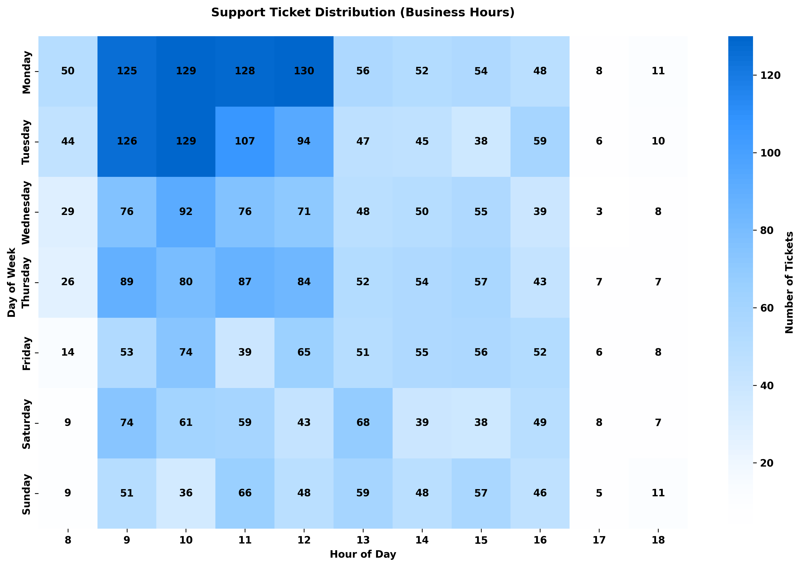

Slide 3
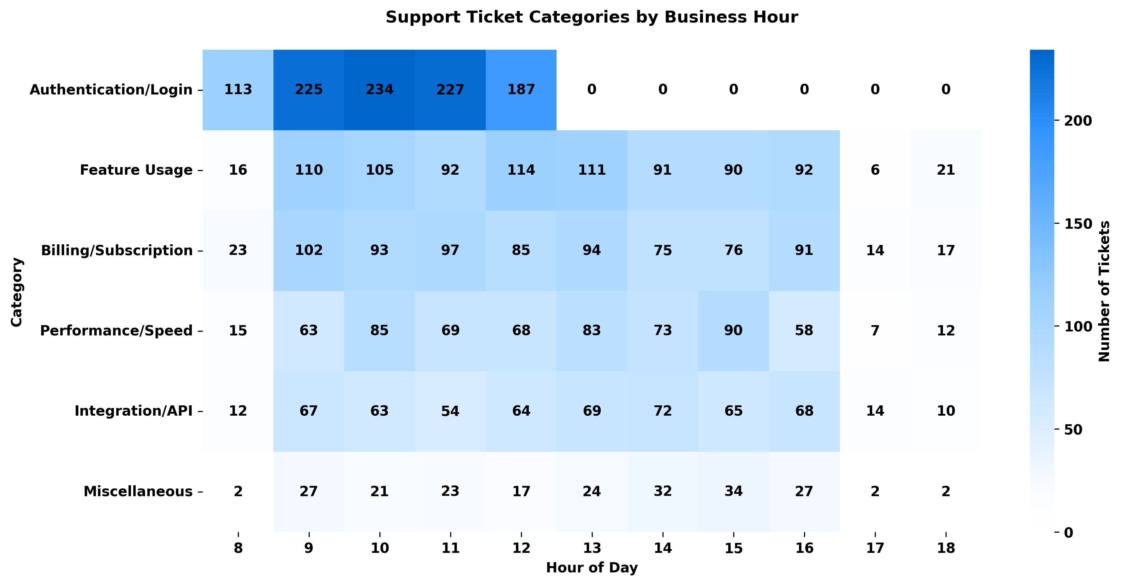

Slide 4
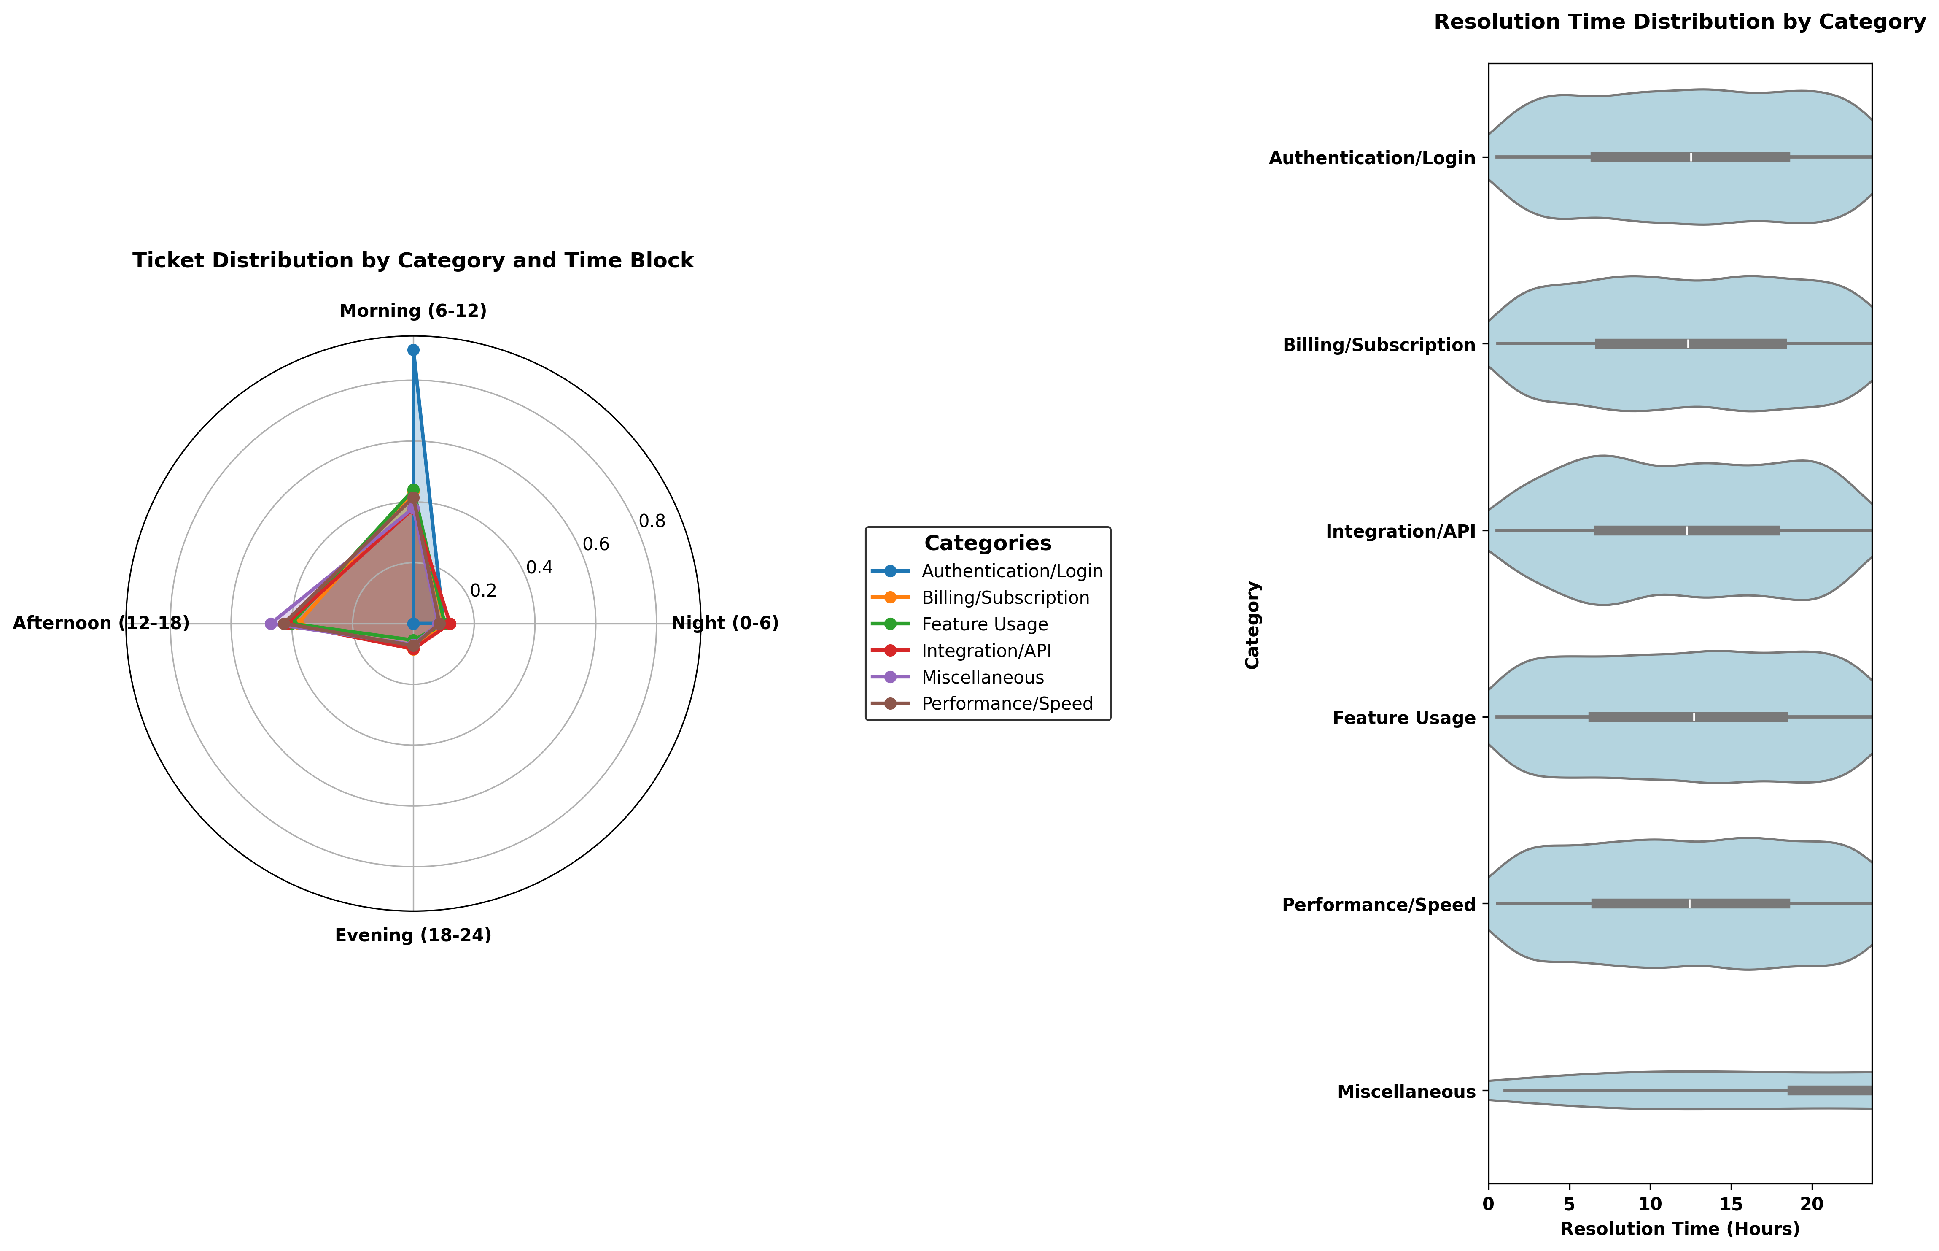

Slide 5

Key Insights
• Authentication/Login Dominates: Highest ticket volume among all categories, indicating a key issue area.
• Peak Ticket Hours: Most tickets are submitted during weekday mornings (10 AM - 12 PM).
• Weekend Dip: Significant decline in ticket submissions on weekends.
• Response Time Bottlenecks: Delays most evident in "Integration/API" and "Performance/Speed."
• Uniform Response Patterns: Similar response times across categories, with some outliers in "Authentication/Login."

